Slide 1
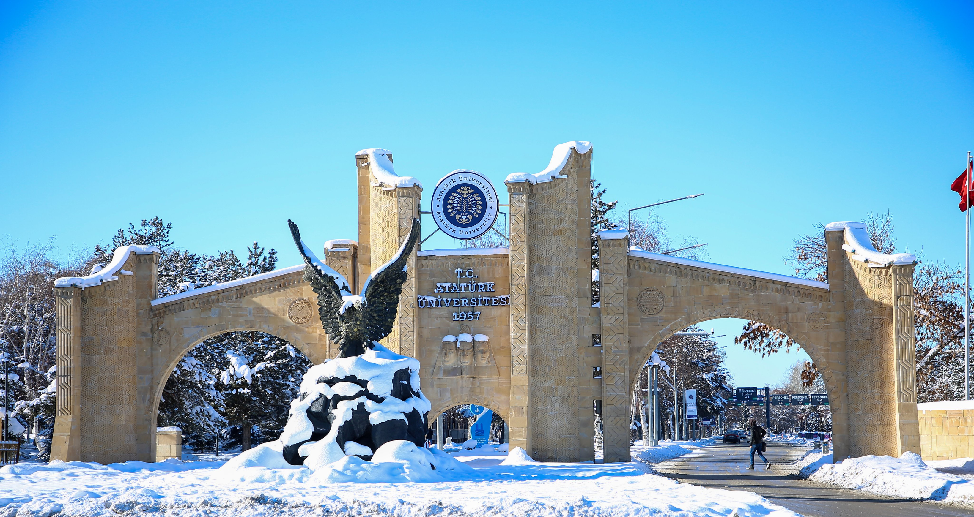
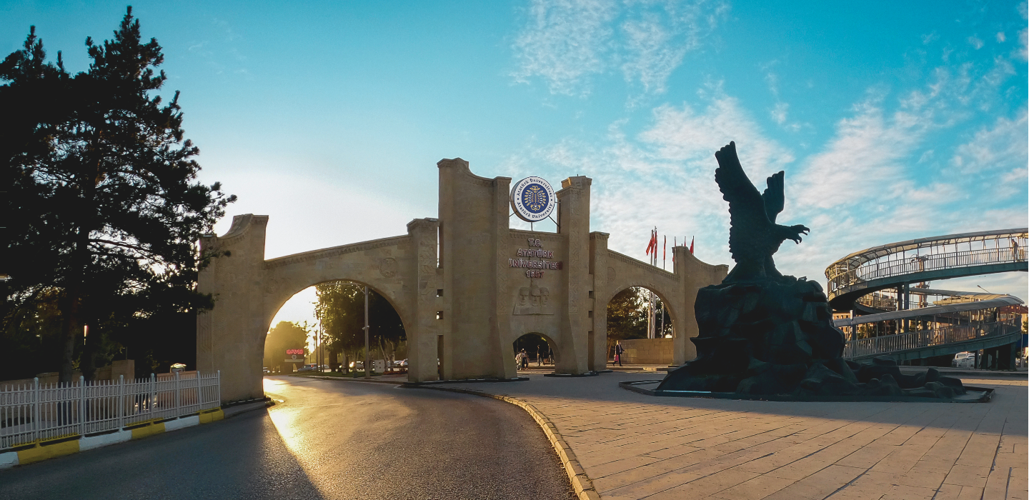



ATATÜRK UNIVERSITY
“Rooted University, Strong Science, Bright Future”

Slide 2


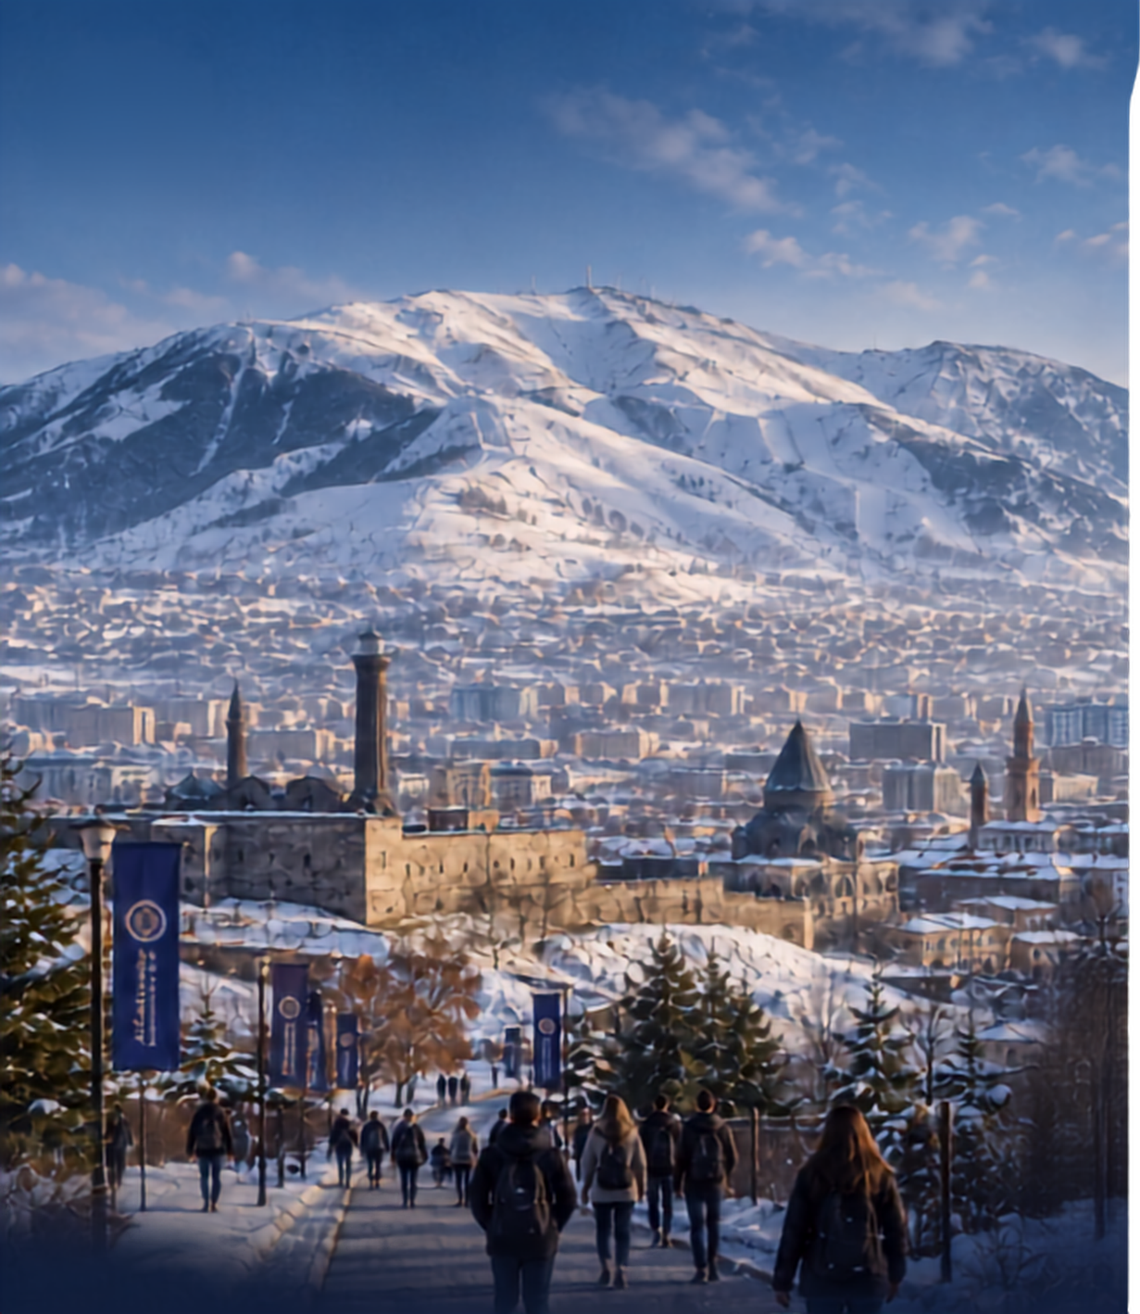
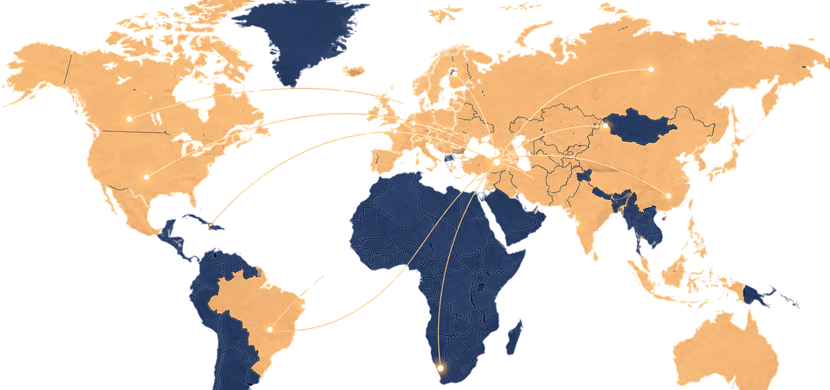

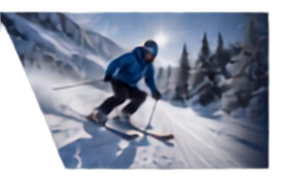





ERZURUM • TÜRKİYE
A NATURAL GATEWAY BETWEEN REGIONS
A historic city on the Silk Road, Erzurum combines a strong academic ecosystem with four-season mountain life and direct links across the Caucasus, Central Asia and the wider region.
High-altitude Campus Life
• Winter Sports
• Culture
• Accessible Living
02

Slide 3
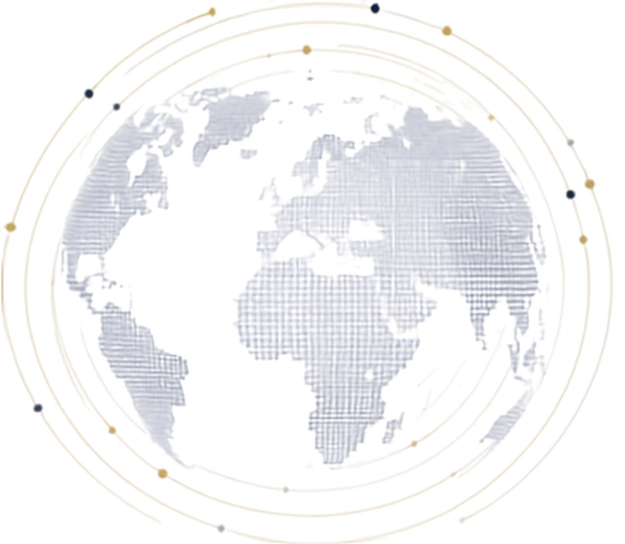




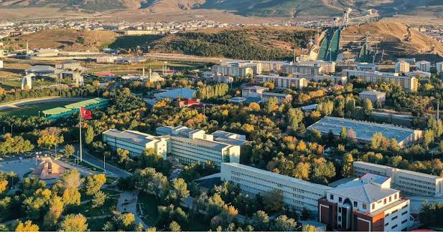



465.000
7.340
INSTITUTIONAL SCALE
A COMPREHENSIVE UNIVERSITY WITH GLOBAL REACH
Students
International Students
1957
Founded in Erzurum
56.350
408.650
Academic staff in total:
2.796
Formal
Open Education
03

Slide 4
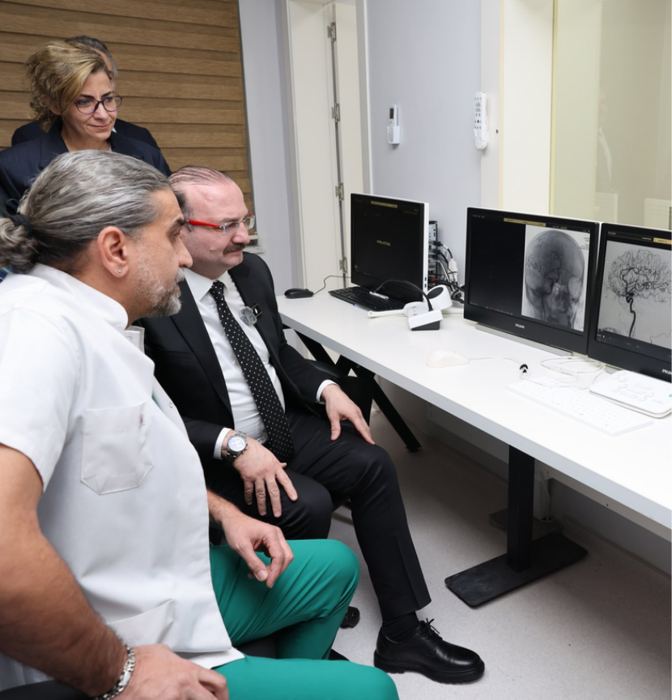





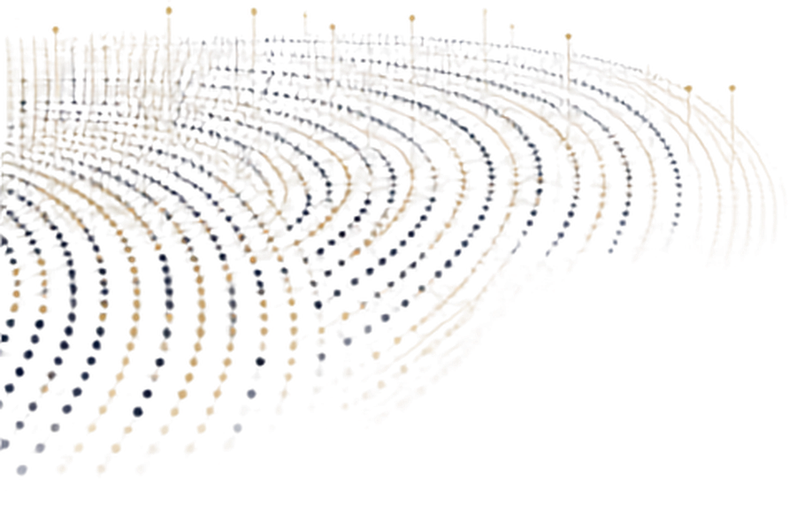
ACADEMIC PORTFOLIO
DEPTH FROM UNDERGRADUATE STUDY
TO ADVANCED RESEARCH
141
Doctoral programs
194
Master's programs
23
FACULTIES
578
Subject areas
GRADUATE
SCHOOLS
9
04

Slide 5
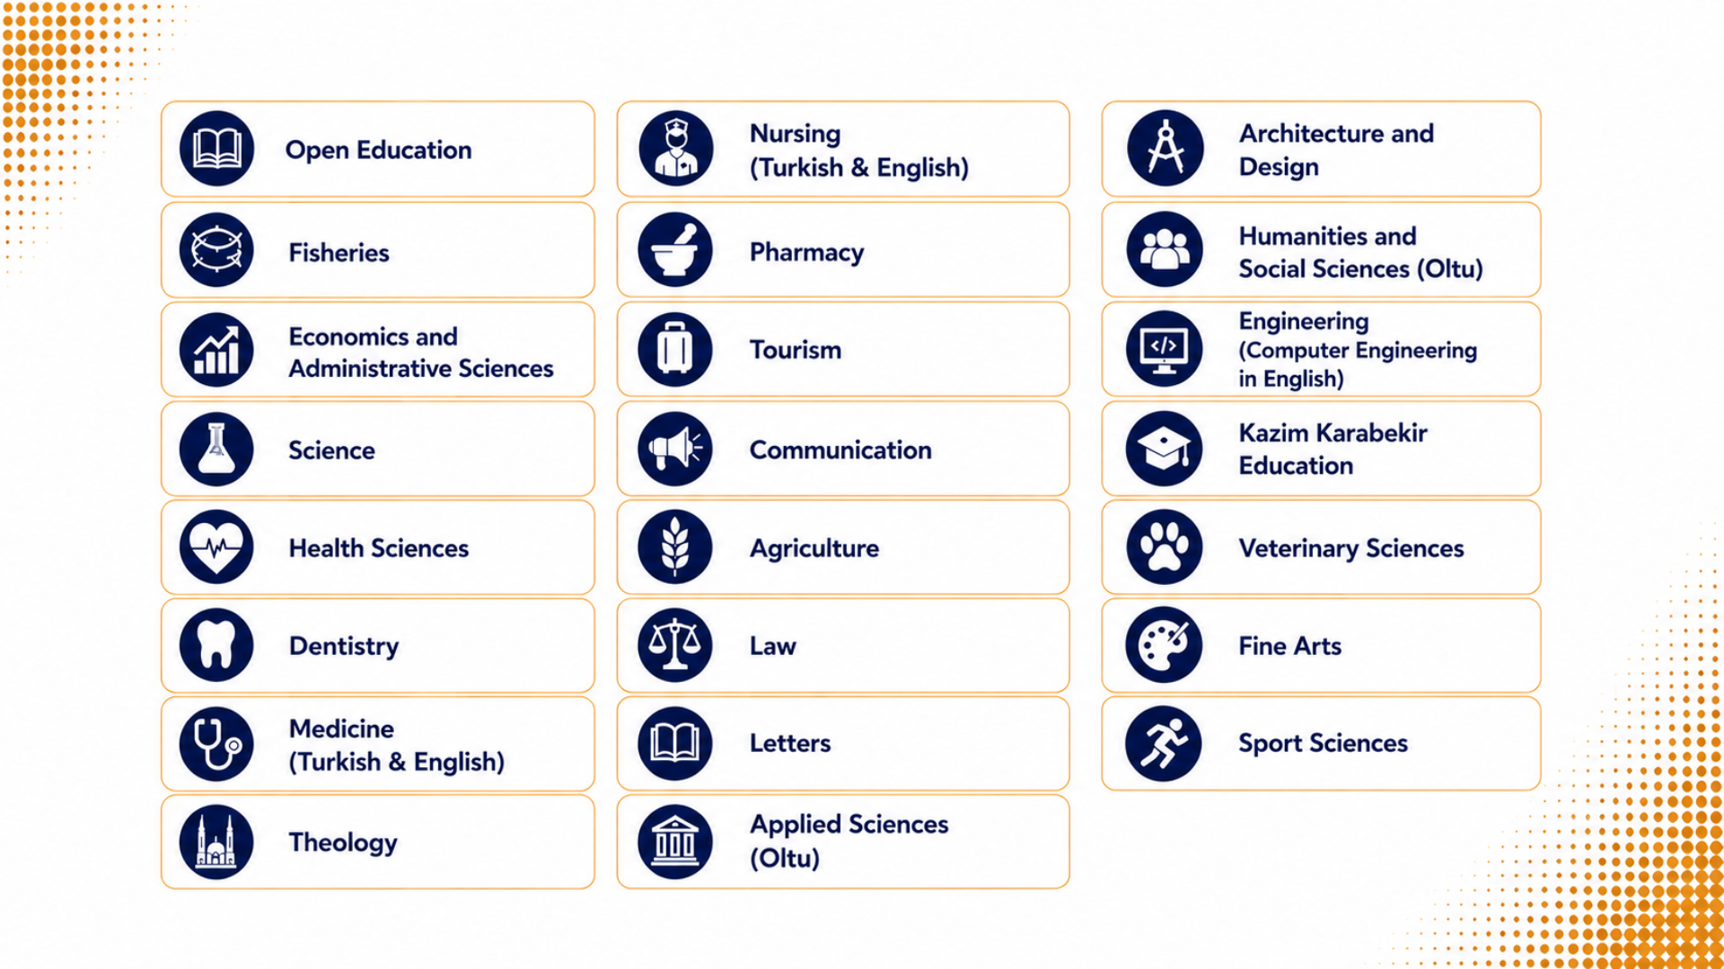
FACULTIES
05

Slide 6
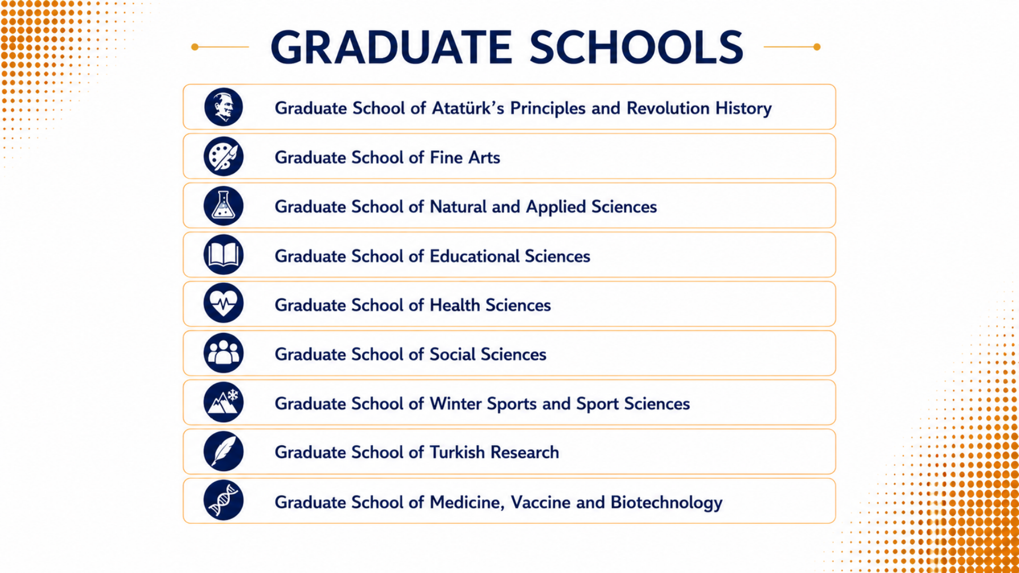
06

Slide 7

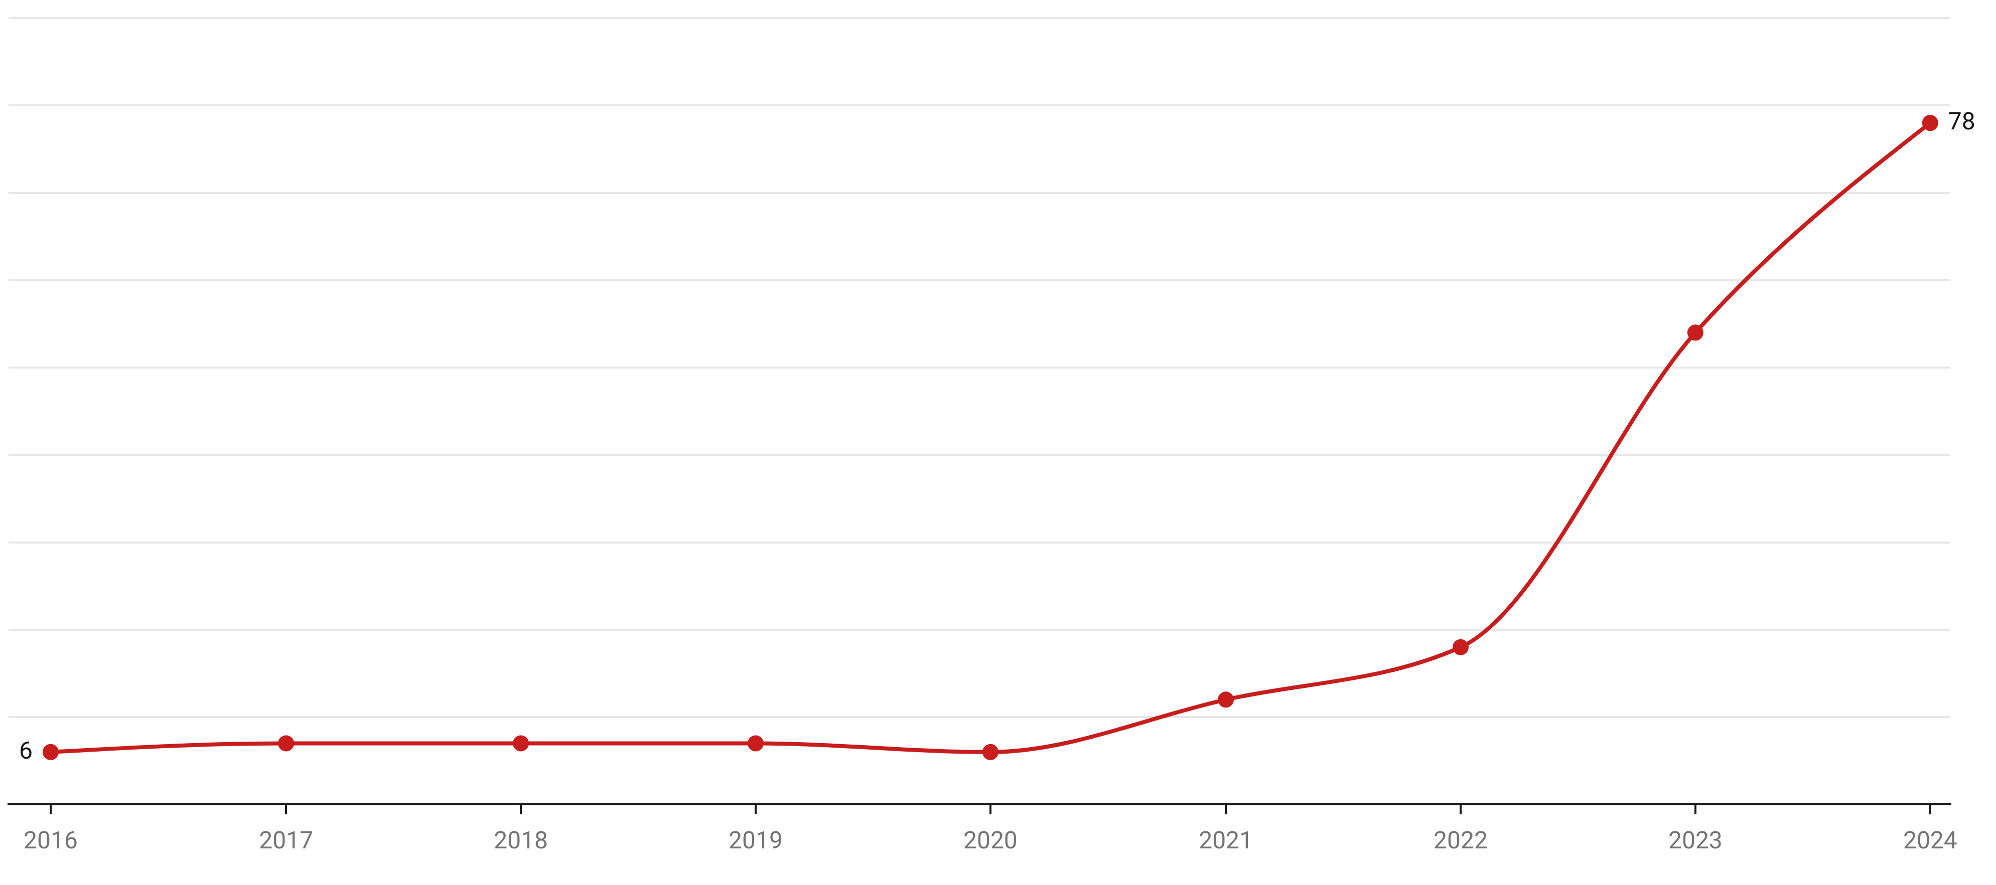
ACCREDITATION
Accredited by YOKAK for 5 years
2030
Accredited Undergraduate Programme Currently (2026)
93
First Ranked in Türkiye
1st

Slide 8



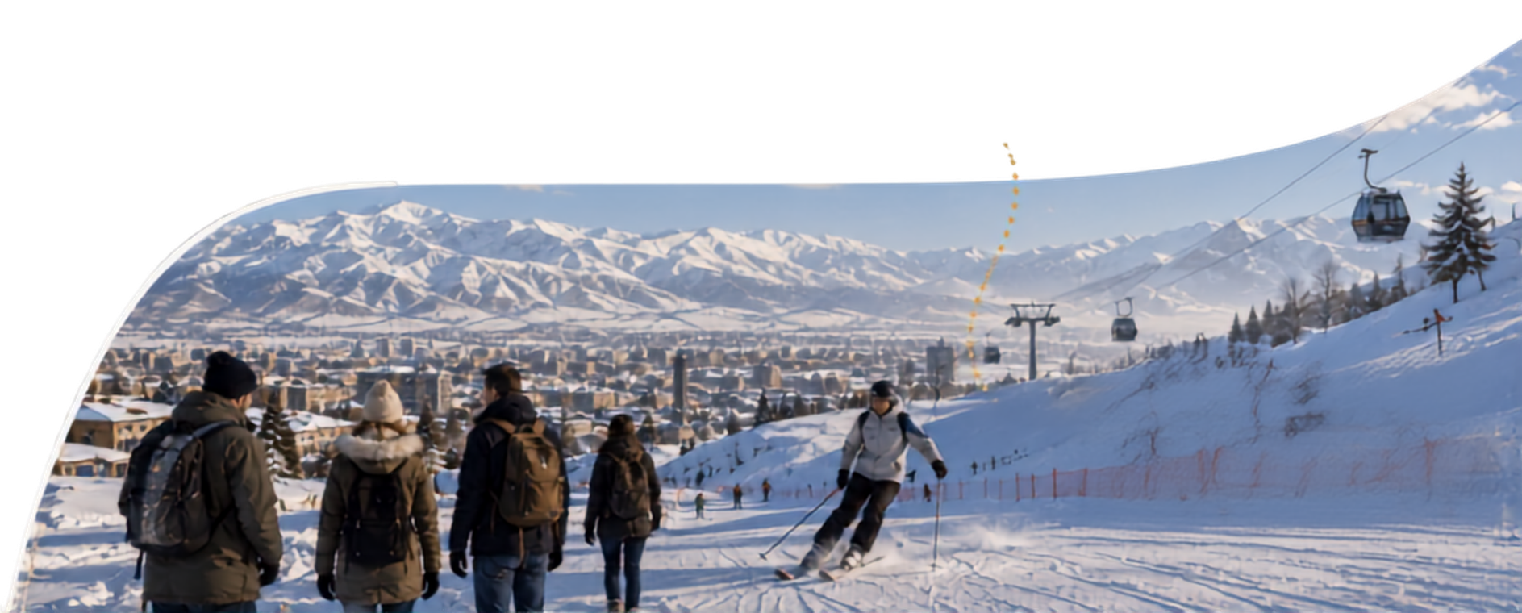

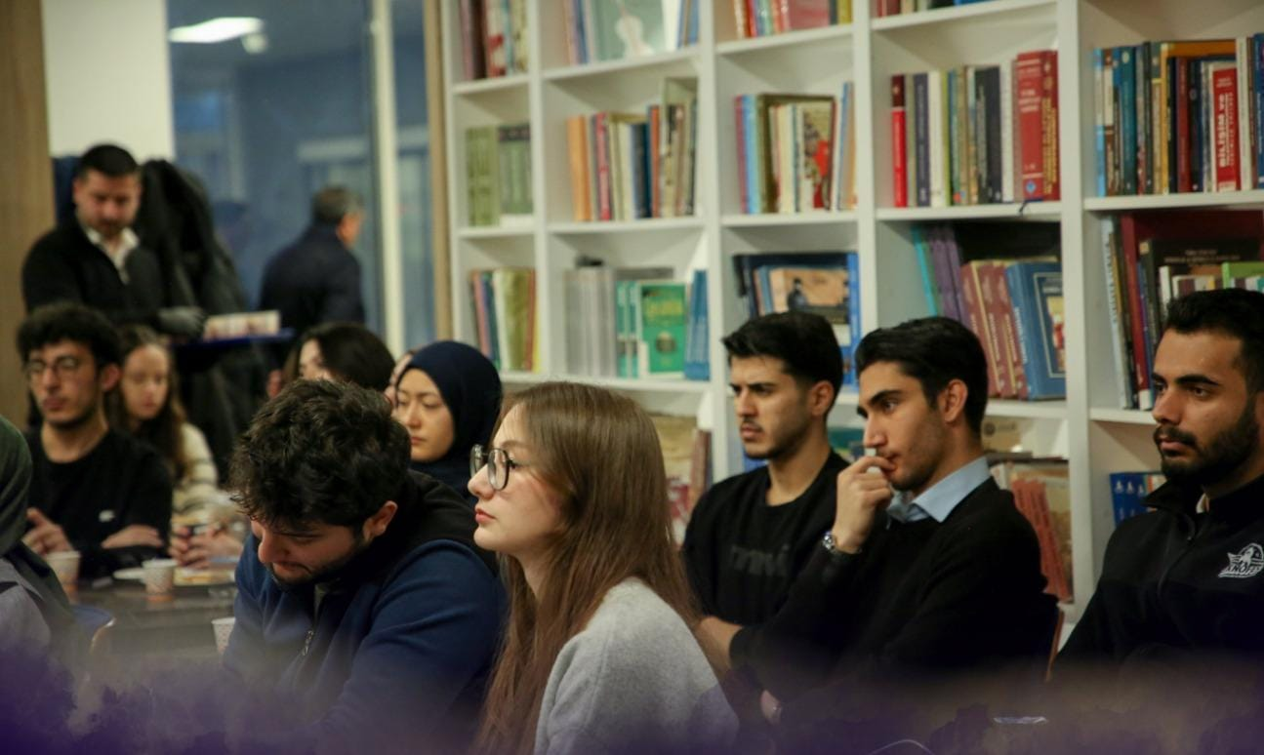

STUDENT EXPERIENCE
A CAMPUS WHERE INTERNATIONAL LIFE
IS VISIBLE EVERY DAY
Living Campus
International Community
Libraries, laboratories, arts, sport and social spaces.
Peer networks, cultural events and mobility opportunities.
Winter-Sport City
Mountain landscapes and Türkiye's leading winter-sport environment.
07

Slide 9
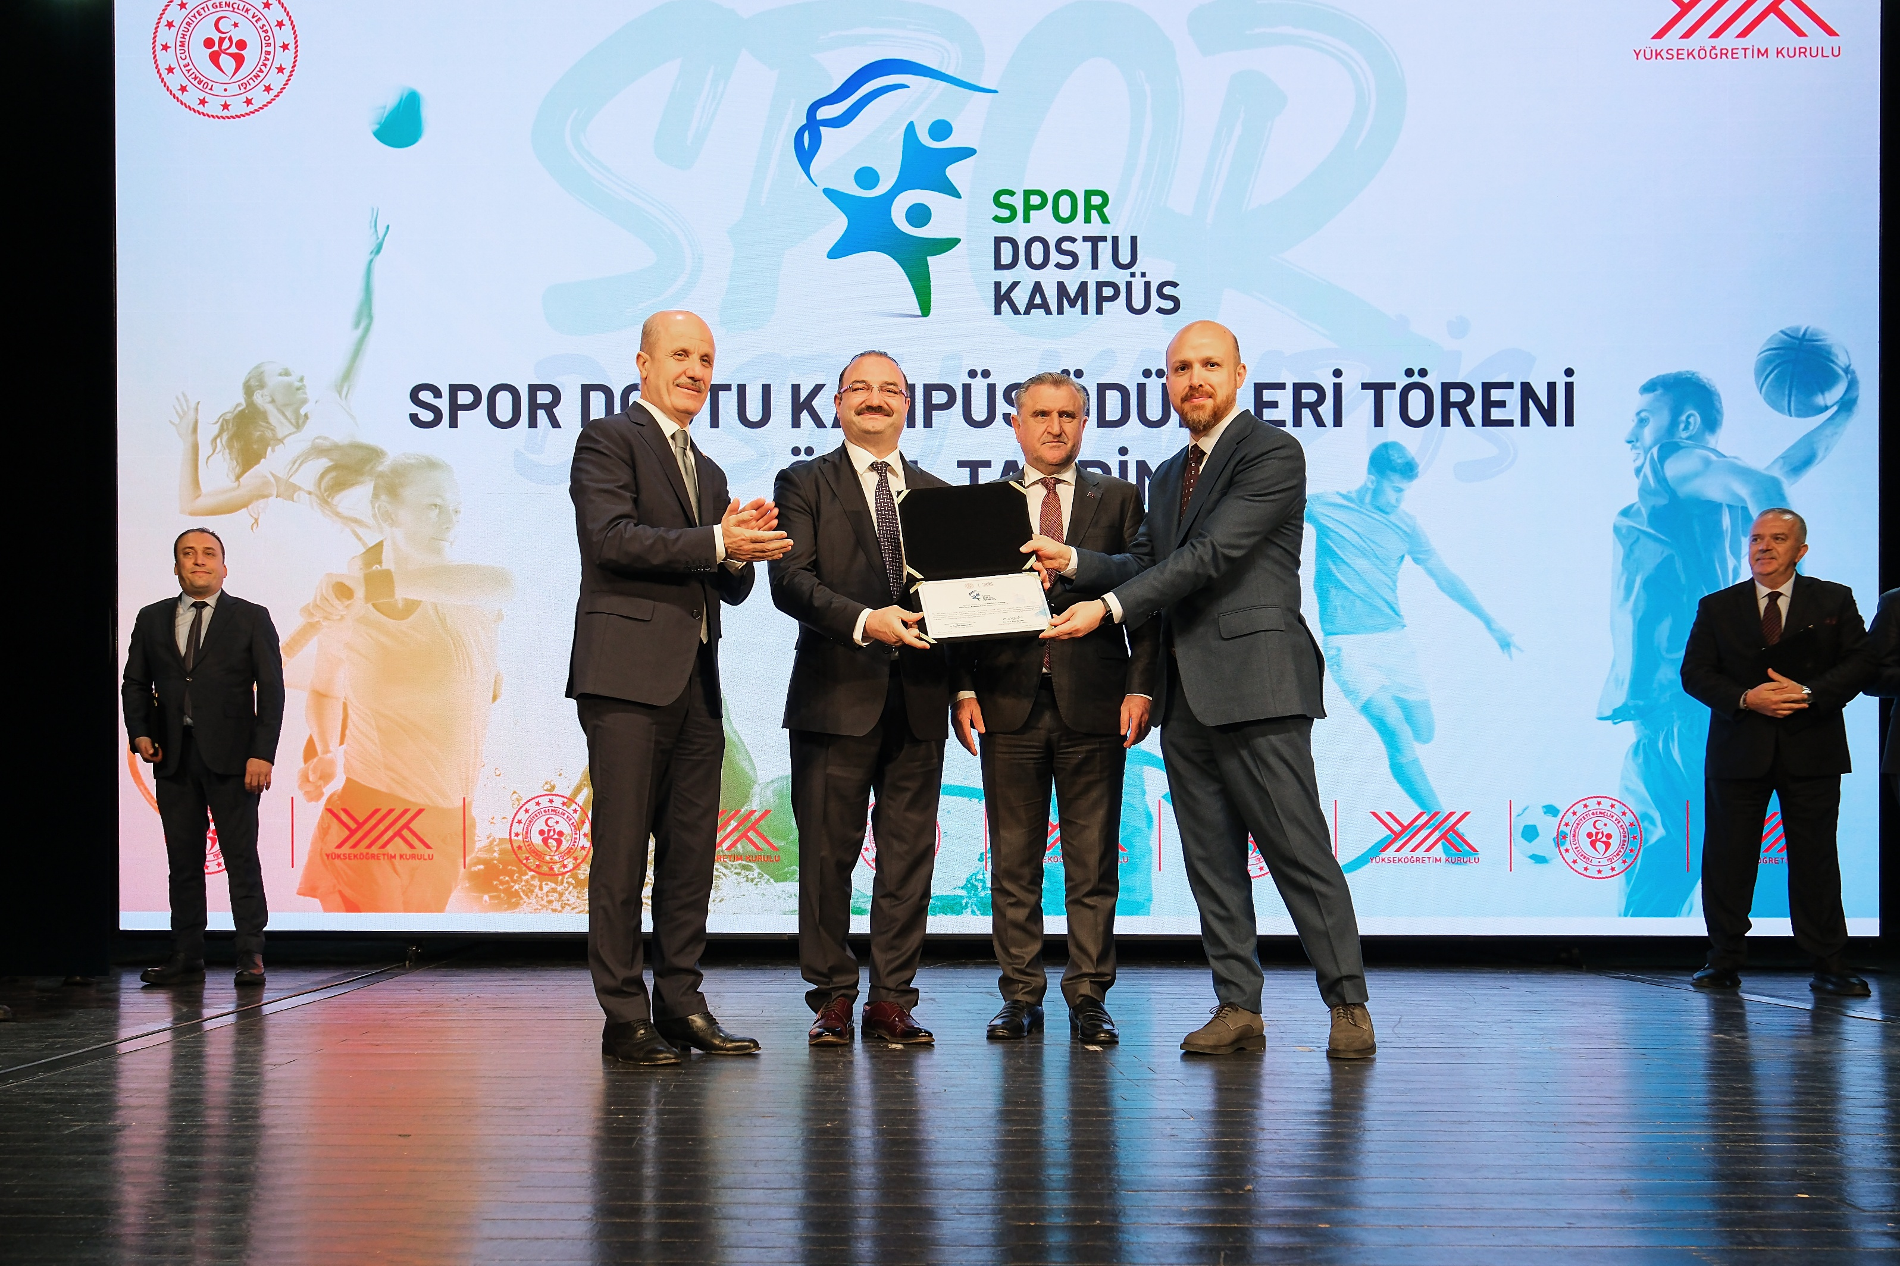
SPORT-FRIENDLY CAMPUS

Slide 10

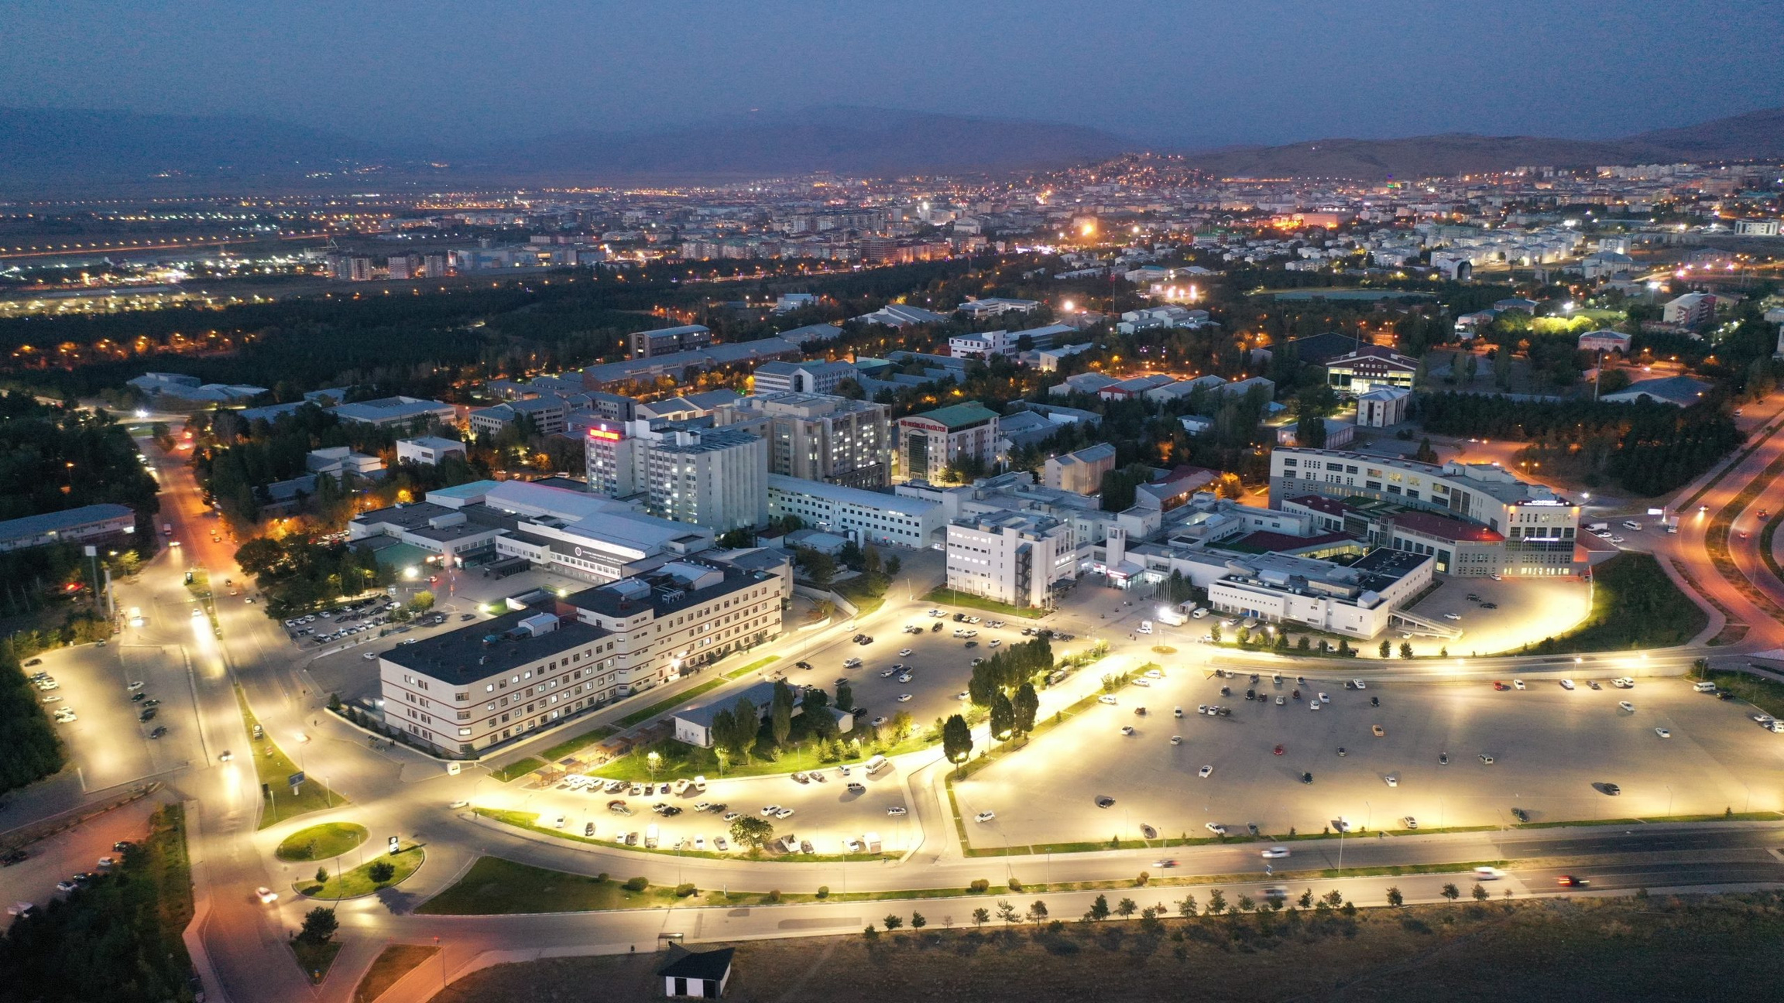


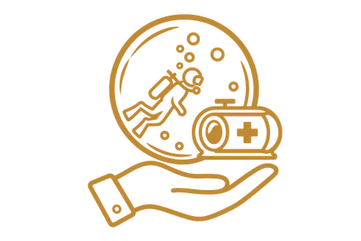

HEALTHCARE • RESEARCH • EDUCATION
RESEARCH HOSPITAL
ADVANCED CARE FOR THE REGION
HEART CENTER
ORGAN TRANSPLANTATION CENTER
UNDERWATER & HYPERBARIC MEDICINE
BONE MARROW TRANSPLANTATION CENTER
13
08

Slide 11
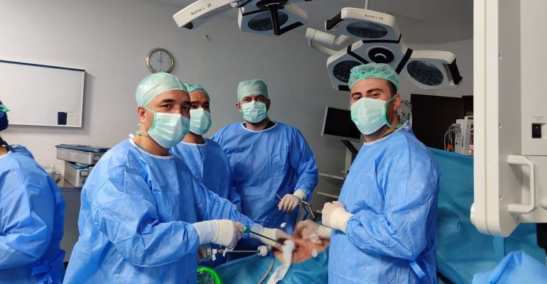

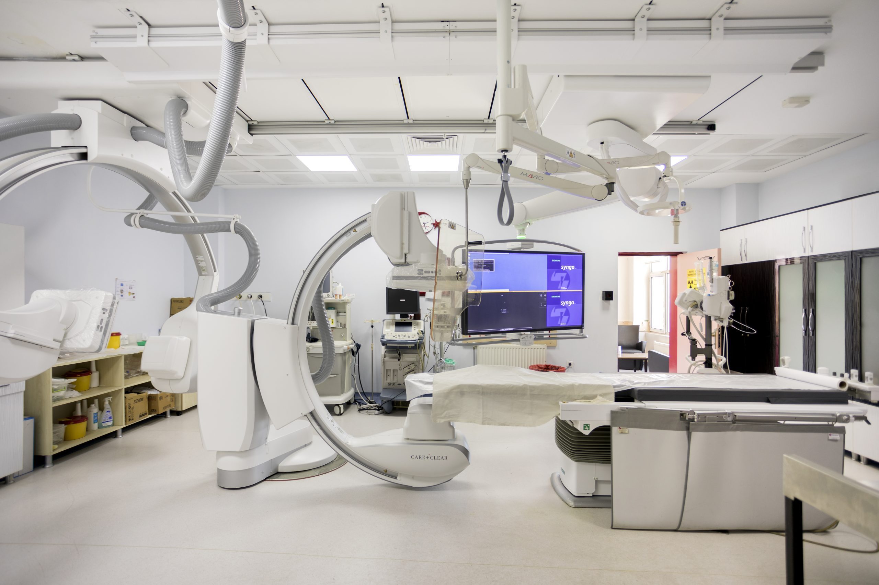

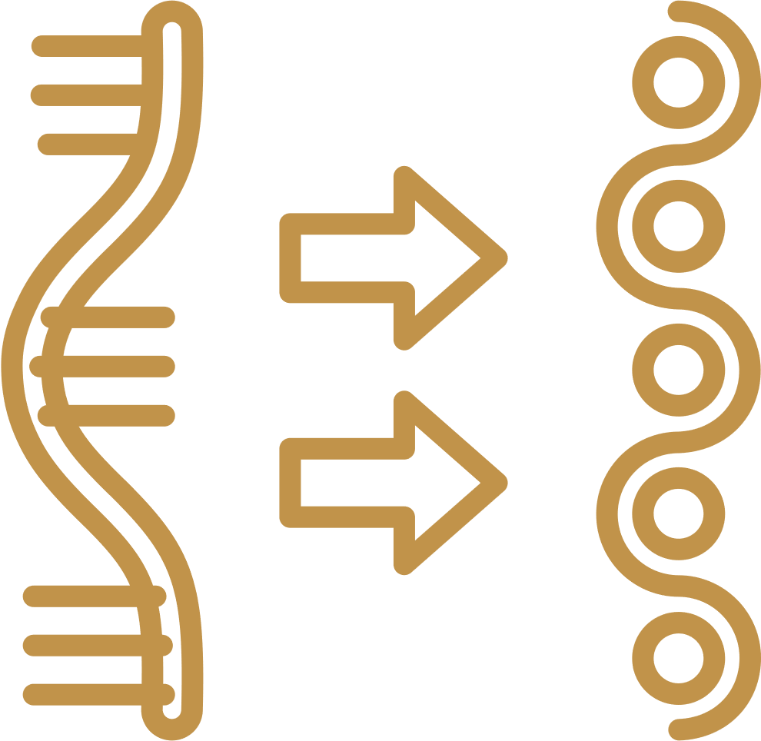

HEALTHCARE • RESEARCH • EDUCATION
INTEGRATED REGIONAL REFERRAL CARE
CLINICAL SERVICES
TRANSLATIONAL RESEARCH
MEDICAL EDUCATION
09

Slide 12

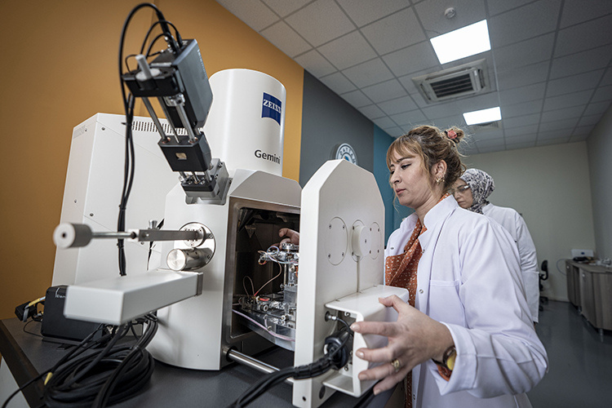







RESEARCH INFRASTRUCTURE
DAYTAM
ADVANCED
RESEARCH HUB
Materials
Life Sciences
Chemical Sciences
Advanced analysis
Clean rooms
Research support
10

Slide 13


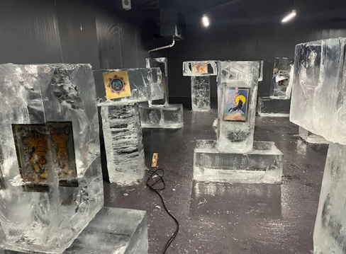
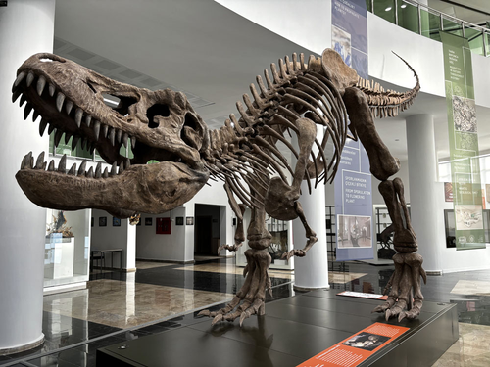
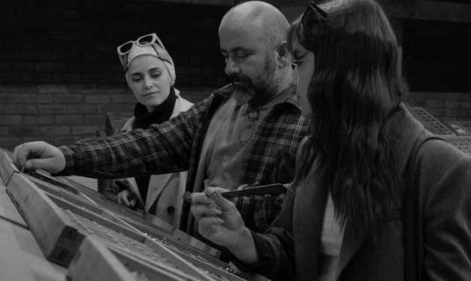




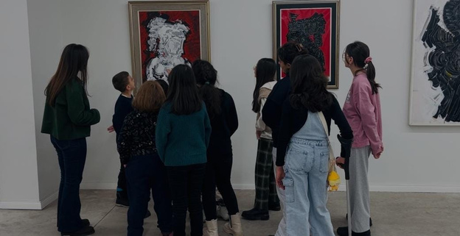
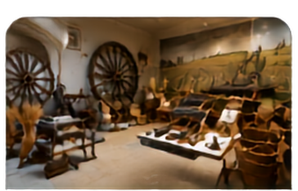
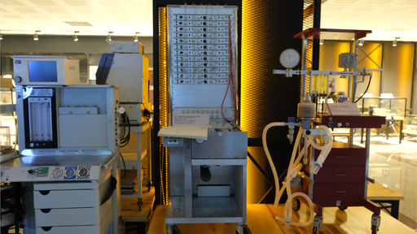



CAMPUS CULTURE & SCIENCE
MUSEUMS
ATA ICE MUSEUM
BIODIVERSITY SCIENCE MUSEUM
PRINTING MUSEUM
Art, technology and climate storytelling in a distinctive cold-space exhibition.
Research collections and public exhibitions focused on Anatolian biodiversity.
Preserving the heritage of traditional printing and typography.
Research collections and public exhibitions focused on Anatolian biodiversity.
DISCOVER • LEARN • PRESERVE
Our museums preserve cultural heritage, advance scientific knowledge and inspire future generations.
FINE ARTS MUSEUM
AGRICULTURE MUSEUM
HOSPITAL MUSEUM
Showcasing artistic works that reflect culture, creativity and inspiration.
Exhibiting the agricultural heritage and traditional farming tools of our region.
Reflecting the history of healthcare and medical education through the years.
11

Slide 14

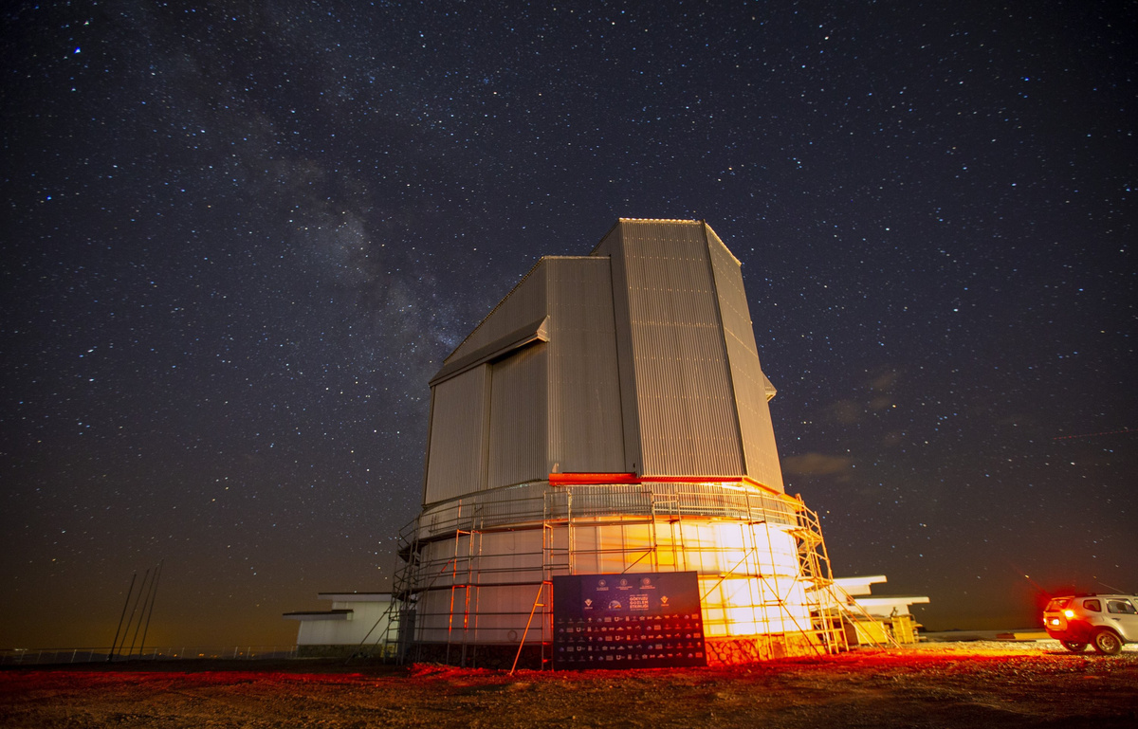








AI & DATA SCIENCE RESEARCH HUB
EASTERN ANATOLIA
OBSERVATORY
OPTICS
4 m telescope
SPECTRUM
Visible + near-infrared
ARTIFICIAL INTELLIGENCE
DATA SCIENCE
INTERDISCIPLINARY RESEARCH
ALTITUDE
3,170 m • Karakaya Hills
MISSION
Astronomy • Astrophysics • Space science
COLLAB.
International research projects
ACADEMIC RESEARCH
COMMUNITY-BASED AI PROJECTS
INDUSTRIAL APPLICATIONS
COLLABORATION • INNOVATION • IMPACT
12

Slide 15


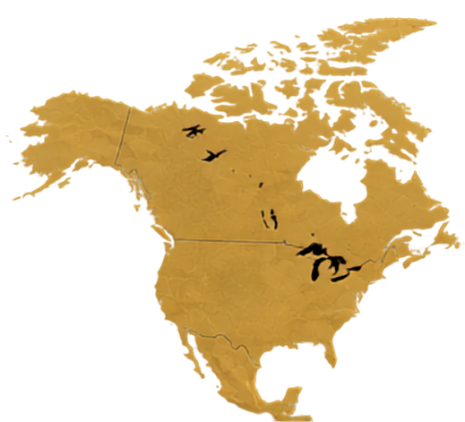
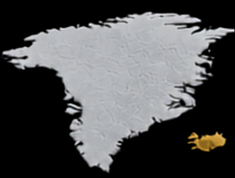
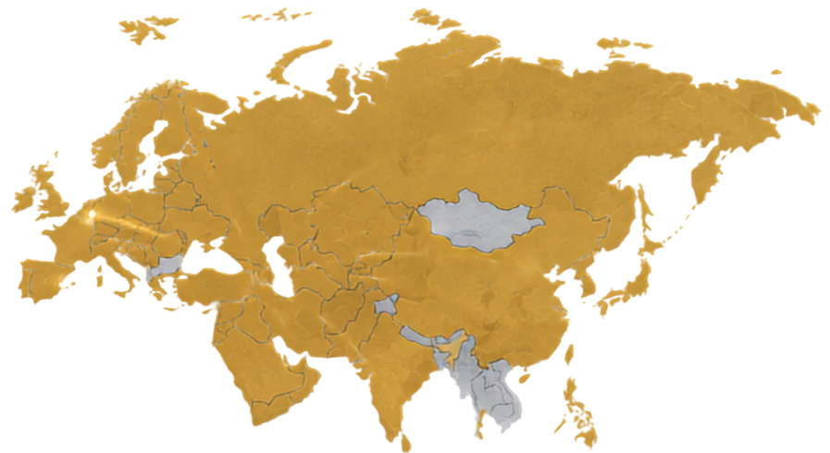








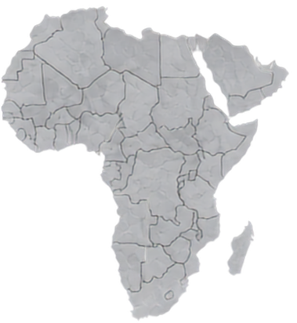

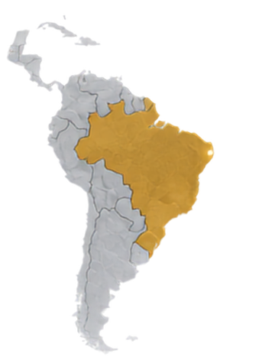






INTERNATIONAL NETWORK
PARTNERSHIPS DESIGNED TO MOVE
PEOPLE AND IDEAS
300
Bilateral agreements
Erasmus+ mobility
Joint degree pathways
Staff and student exchange
Collaborative research
Cooperation across education, mobility and research
13

Slide 16
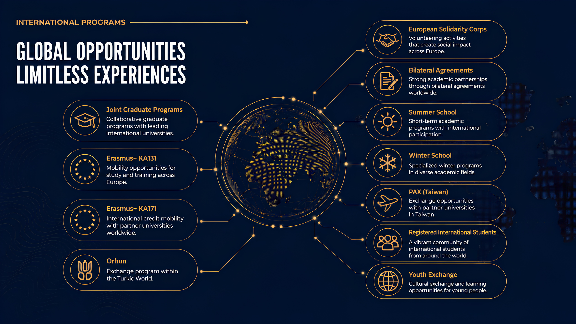
14

Slide 17



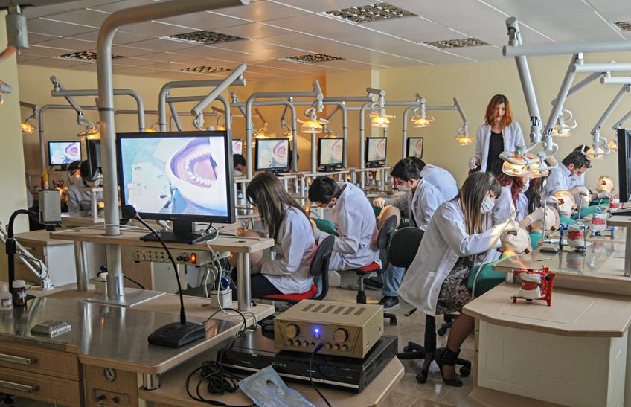



RESEARCH IMPACT
QUALITY AND CITATION IMPACT ARE ACCELERATING
2025 papers in the world's top 10% most-cited publications
231
Top 10% most-cited publications
in Türkiye
TIMES HIGHER EDUCATION RANKINGS 2026
#1
#9
#801-1000
for Clarivate InCites indicator
TÜRKİYE
WORLD
15

Slide 18

RESEARCH
NUMBER OF SCI/SCIE ARTICLES
GROWTH IN PUBLICATIONS

Slide 19
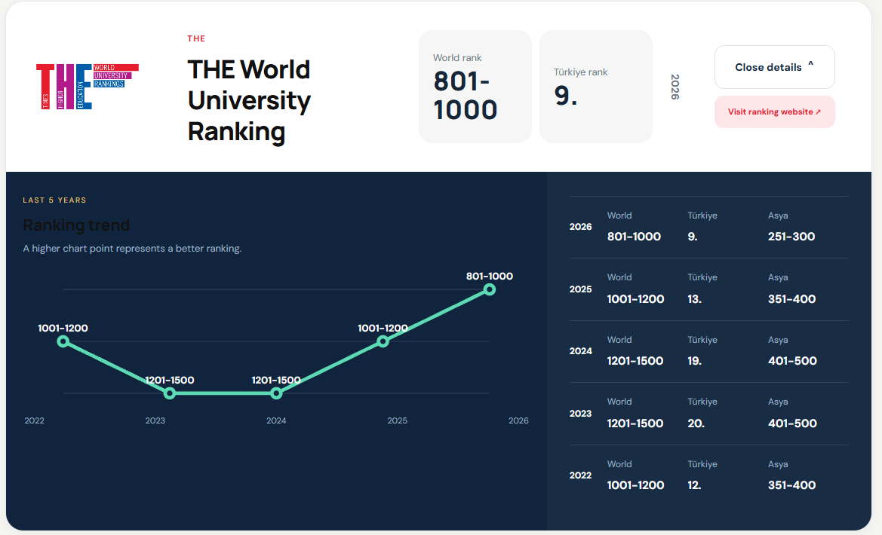
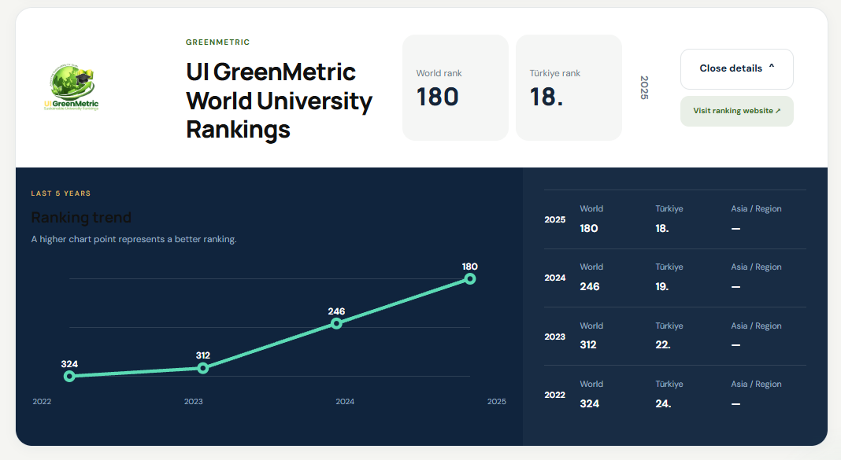
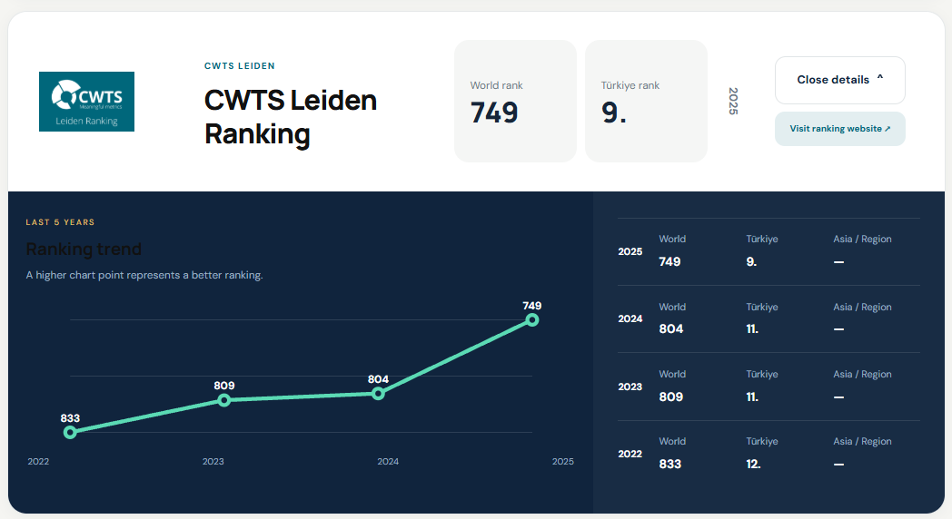
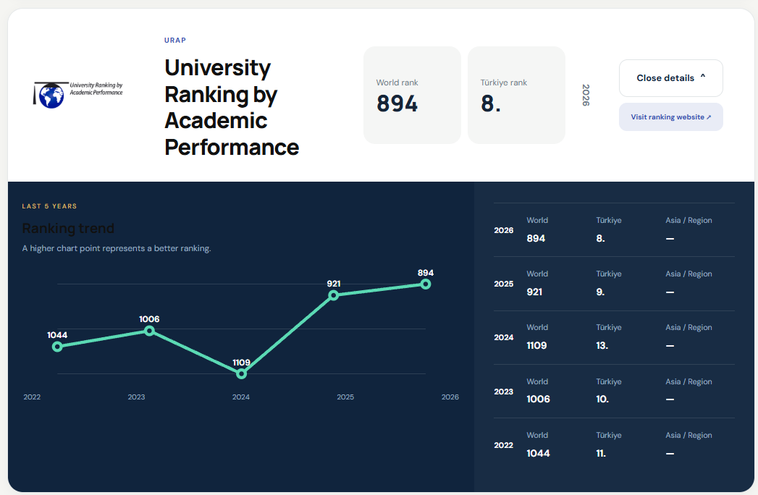
GETTING HIGHER RANKINGS GLOBALLY
RESEARCH IMPACT
15

Slide 20
























RESEARCH IMPACT
THE SUBJECT RANKINGS
Arts & Humanities
2026
Medical & Health
2026
Education Studies
2026
Engineering
2026
601-800
th
601-800
th
501-600
th
601-800
th
Life Sciences
2026
Physical Sciences
2026
Social Sciences
2026
501-600
th
501-600
th
601-800
th
16

Slide 21
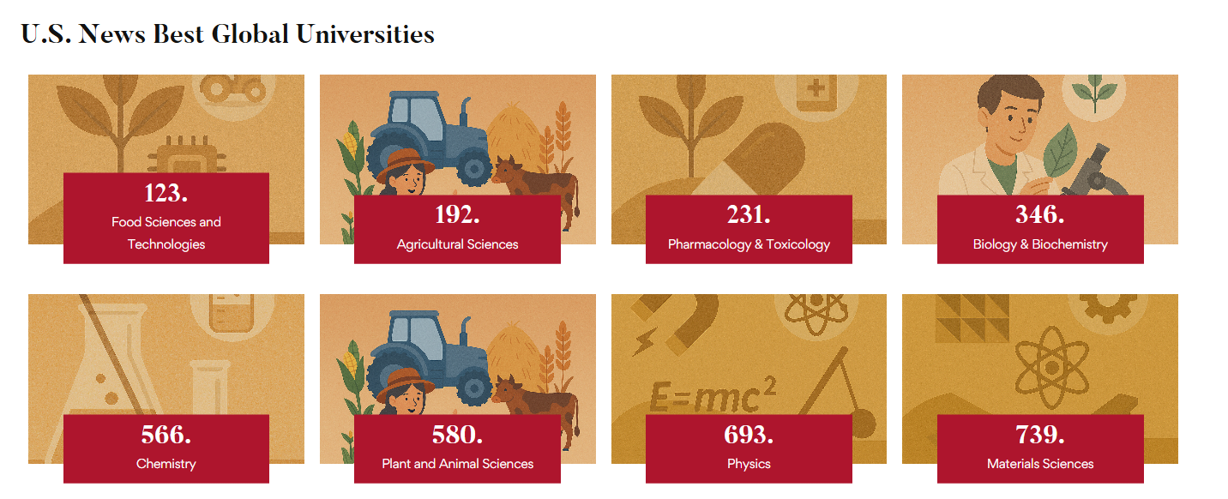
SUBJECT RANKINGS

Slide 22
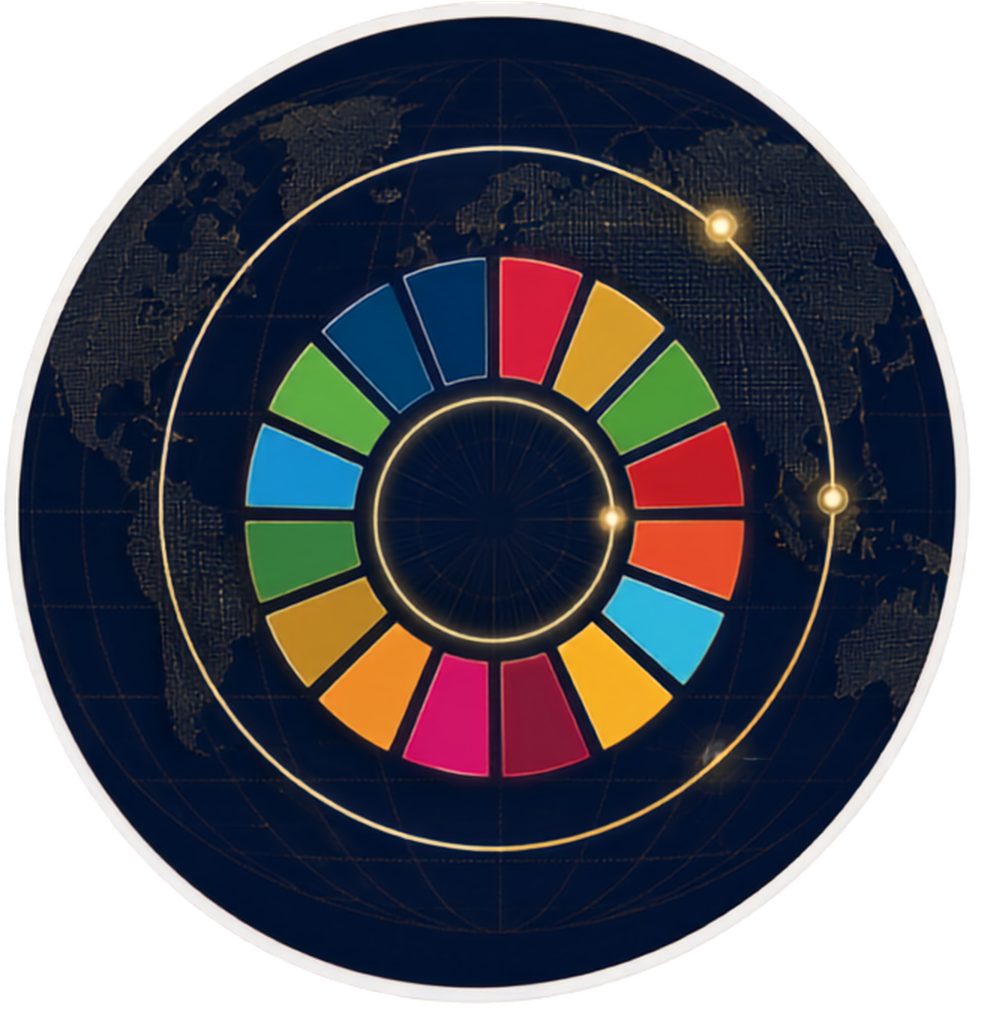




SUSTAINABILITY
GLOBAL RECOGNITION ACROSS
THE SUSTAINABLE DEVELOPMENT GOALS
(SDG)
SDG areas ranked in the world top 10
3
fields
SDG areas ranked #1 in Türkiye
9
fields
SDG
SDG areas ranked in the world top 50
12
fields
17

Slide 23
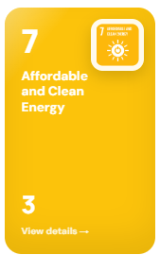
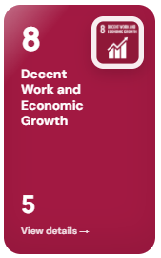
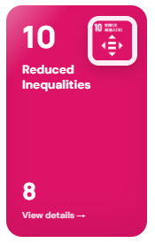
SUSTAINABILITY
GLOBAL RECOGNITION ACROSS
THE SUSTAINABLE DEVELOPMENT GOALS
(SDG)
Ranked #3 in the World
Ranked #5 in the World
Ranked #8 in the World
17

Slide 24

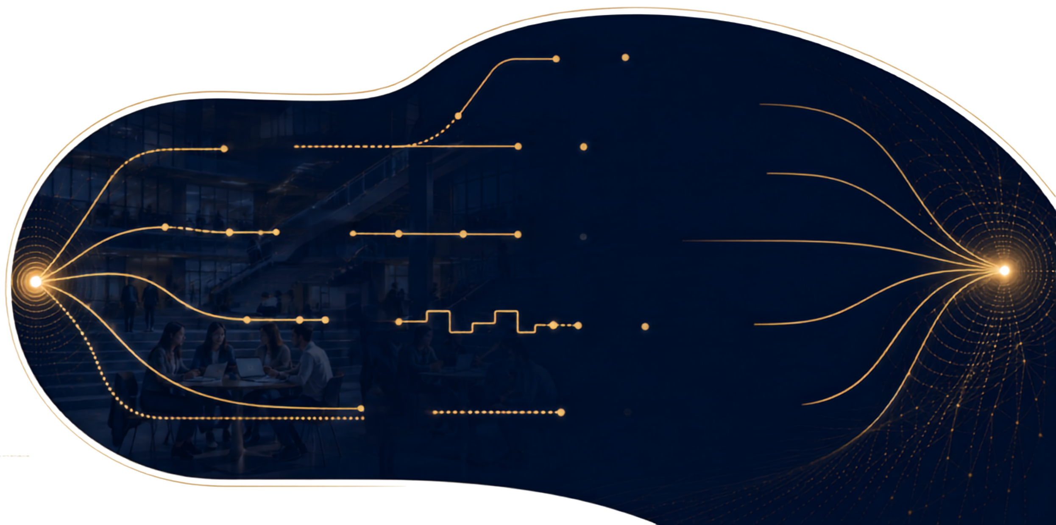






PARTNER WITH US
FIVE PRACTICAL ROUTES TO BUILD LASTING COOPERATION
01
    Joint Education
Double degrees, joint modules and co-supervision.
02
    Mobility
Student and staff exchanges with academic purpose.
03
    Research
Consortia, shared infrastructure and co-publication.
04
    Innovation
Applied projects with industry and public partners.
05
    Global Engagement
Summer schools, conferences and cultural diplomacy.
18

Slide 25
